Slide 1
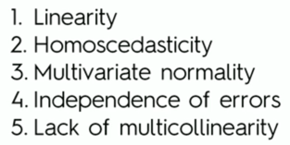
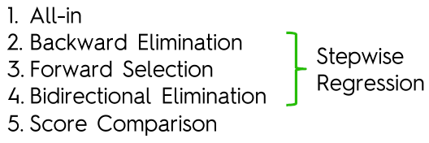
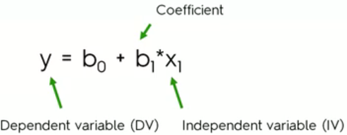
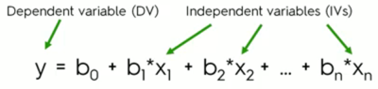
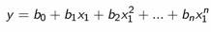
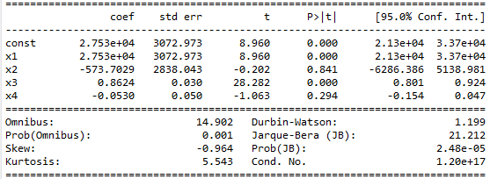
Evaluate Model
Is Linear regression a good fit?
Assumptions of a valid linear regression
If Linear model valid
MULTIPLE
SIMPLE
Step to decide features
to keep in the model
Simple linear regression
Multiple linear regression
Polynomial regression
SVR
Decision Tree
Random Forest
Random Forest
Linear models
NON Linear models
Evaluating Methods
Adjusted R² to measure performance of Regression Model

Slide 2
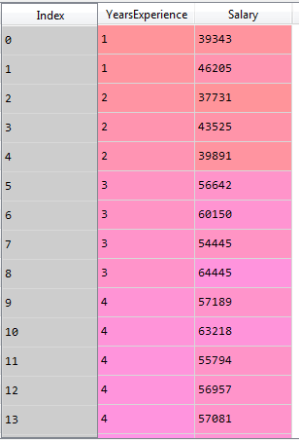
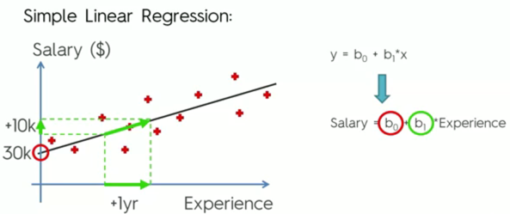
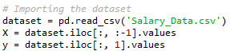
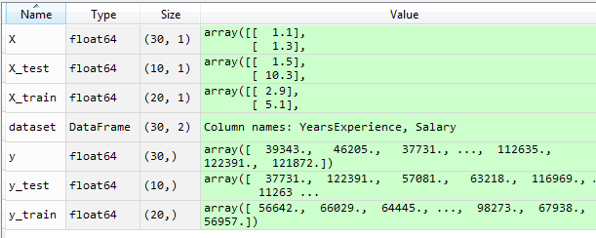
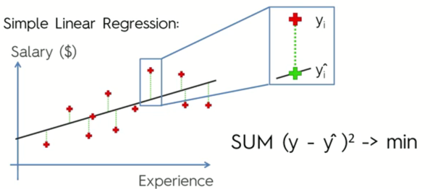
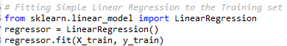
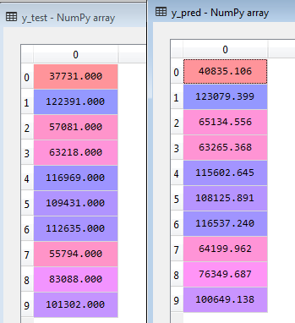
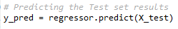
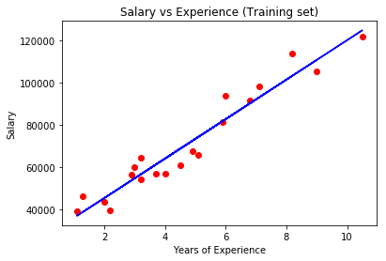
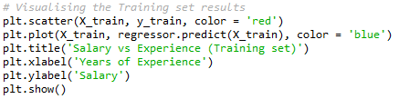
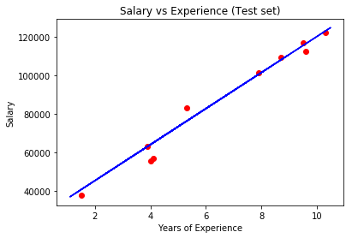
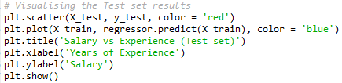
SIMPLE LINEAR REGRESSION
Import dataset
Data Pre-processing
Split the dataset into train (2/3) and test set (1/3) of the values.
Do not need to feature scaling as the ‘linear regression’ class already include that in python
Fit to the training set
First we create a linearRegression class, and then Fit training set (X and Y) using the regression class linearRegression
The output value is entered into the regressor class
Use the regressor class recently created to predict the results. For that, we now enter as an input for the regressor the X_test set and expect it to return the predicted values (y_pred)
This step can be omitted as we do not use y_pred unless to verify results
Predict the test set results
Visualizing training set results
The prediction is now done, but we have now to plot it graphically and compare training set with test set.
Firstly we create a scatterplot with all the training (X and y) plots (scatter).
And secondly plot the fit line using the plot function with inputs X_train and the predicted values obtained using X_train
Visualizing test set results
We repeat the same process but now in a scatter where we have plotted the testing set values

Slide 3
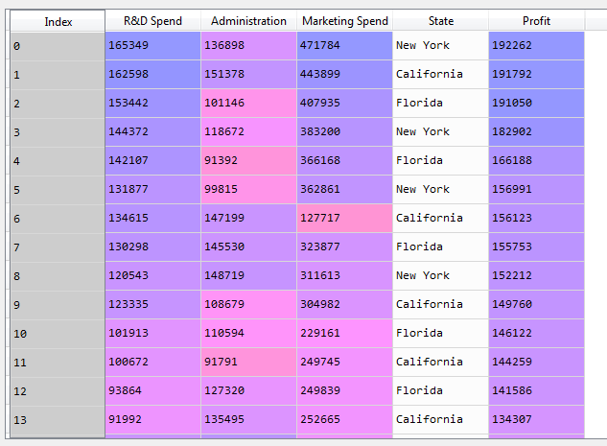
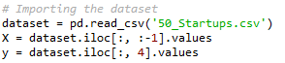
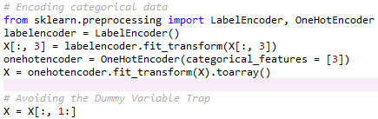
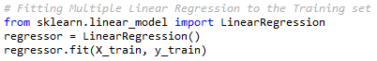
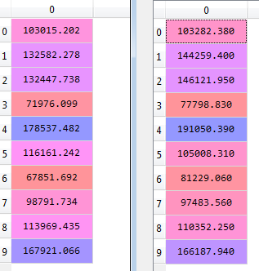
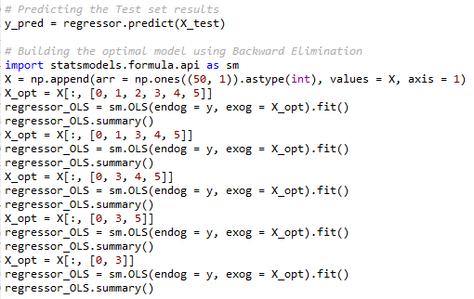
MULTIPLE LINEAR REGRESSION
Independent
Profit
Import dataset
Dependent
Spend
Administration
State
……
……
Data Pre-processing
Since we have a column with categorical data, we have to take care of it with the labelencoder class.
We have included also an example of how to take care of dummy trap issue, but python fix that automatically (added as reference for other languages)
Split
Split the dataset into train (80%) and test set (20%) of the values.
Do not need to feature scaling as the ‘linear regression’ class already include that in python
Fitting
First we create a linearRegression class, and then Fit training set (X and Y) using the regression class linearRegression
The output value is entered into the regressor class
Predict the test set results
We do this step so we can compare the vector of predictions with the actual values (y_test) to see how we are predicting
We are not plotting a graph for this model as we would need 5 dimensions.
Now we are going to find which are the variables that are more statistically significant for the dependent variable, and which not (the once that can be removed)
Build the model using Backward Elimination or similar technique
1. First problem we have with multiple regression is that in the matrix of independent variables we do not have b0 coefficient as we have to have.
2. So we create the statsmodel class and add a new column of ones (np.ones) that will be added to our matrix of features to represent the missing coefficient
Backward Elimination steps
3 Then create a class OLS , from statsmodel library, and pass the matrix with all the features. A new table is created with the p-value for each
4. Then remove the p-value which is highest in the list and execute the same process again till all the remaining values have p-value < 0.05 (statistically significant)

Slide 4
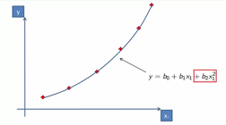
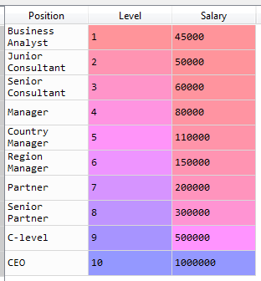
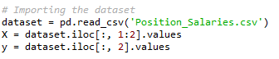
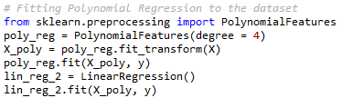
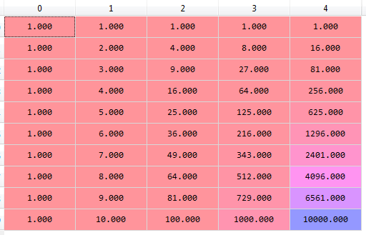
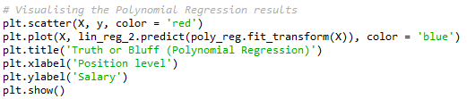
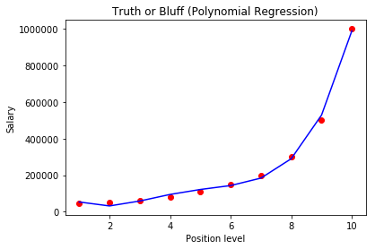
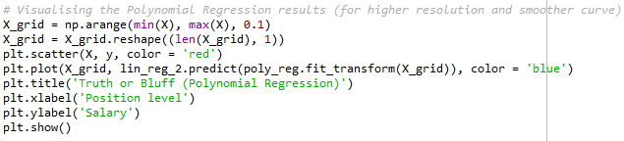
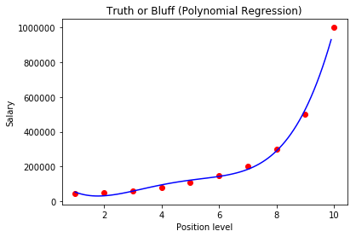
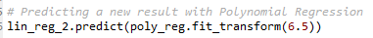
*In this sample we do not split the data because: 1. have few data. 2. we cannot split the dataset or it will lose meaning
Polynomial Regression
Import dataset
In this case of use we want to predict the new salary of an employee according to his experience and hence, find out if he
is bluffing with his actual salary
Fitting regressor to training set
The python polynomial regression class is Polynomialfeatures. It receives as an input the number of dependent variables (4), and then:
Use the code poly_reg.fit_transform(X) to update the matrix of features by adding the polynomial coefficients
Fit the resulting set from 1 with the dependent variable
Use the linearRegression class to fit X and y (the same than in 2)
Polynomial regression is used when a linear regression doesn't fit well the data
Use Case: PR algorithms are used for example to describe sickness or epidemical spread
It differentiates from multiple linear regression due to the power of dependent variables as they increase exponentially
The right table represents x_poly matrix, being the last 3 columns the squared calculations of x
Visualizing results
Now we use a scatterplot to visualize the results . For that we do:
First a general scatterplot using original dataset (X, y)
Second, plot the regression line. For that we use the linearRegression class, passing the Polynomialfeatures objects as input with the method (predict)
Visualizing results (higher resolution)
We can use a grid of values x to plot the results in more detail
Predict
Finally we use the method predict of the linearRegression class to obtain the predicted value. Whilst the class used is ‘linearRegression’, it has been previously fitted with the X_poly matrix of features:
lin_reg_2 = LinearRegression()
lin_reg_2.fit(X_poly, y)

Slide 5
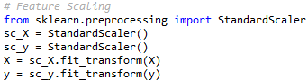
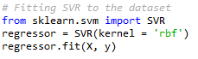
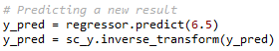
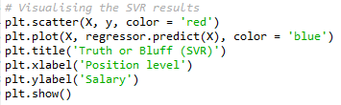
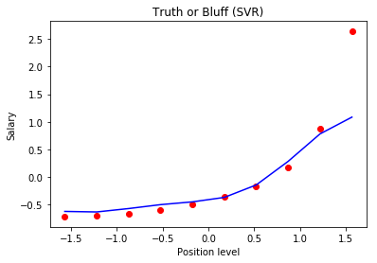
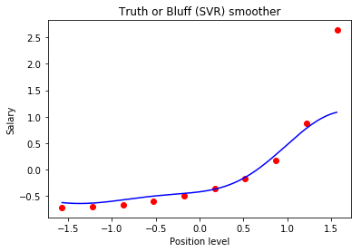
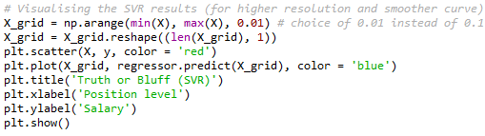
SVM
Import dataset
We will use the same dataset than in the polynomial regression
Feature scaling
In this case we do have to do feature scaling, because the SVR class doesn’t include the feature scaling by default,, as for example the linear regression or polynomial regression do
We create two separated StandardScaler classes because each will go to a separate array (X and y)
Fitting SVR to the dataset
As usual:
Create corresponding class for the algorithm we have to apply: SVR
Create object of the class
Fit the object to the dataset (X and y)
Predicting a new result
We are going to make the predictions based on a specific score (6.5)
Visualizing results
Visualizing results (higher resolution)

Slide 6
DECISION TREES
Import dataset
We will use the same dataset than in the polynomial regression
Feature scaling
Like in SVR we have to do feature scaling as the algorithm for decision trees doesn't’t include it by default
Fitting Decision Tree to the dataset
As usual:
Create corresponding class for the algorithm we have to apply: SVR
Create object of the class
Fit the object to the dataset (X and y)
Predicting a new result
We are going to make the predictions based on a specific score (6.5)
the decision trees model is not a linear function so the graph takes the form of a stair with different levels
Visualizing results

Slide 7
RANDOM FOREST
Import dataset
We will use the same dataset than in the polynomial regression
Feature scaling
Like in SVR we have to do feature scaling as the algorithm for decision trees doesn't’t include it by default
Fitting SVR to the dataset
As usual:
Create corresponding class for the algorithm we have to apply: SVR
Create object of the class
Fit the object to the dataset (X and y)
Predicting a new result
We are going to make the predictions based on a specific score (6.5)
As can be spotted, the random forest creates more levels between data points.
This is a very small dataset, but in a larger set the levels (leafs) would be more evident
We can chose the number of trees that we want to use in the variable n_estimators of the random forest class, but the graphic shape won’t change much because all the decision trees tend to converge (entropy)
Visualizing results

Slide 8
Evaluating Regression Models Performance
SUM Squared of residuals
SUM Squared of totals
1 - least squared regression give us the measure of performance of the regression model
When SSres/SStot is equal to is equal to 0, R² is equal to 1 and that would mean that all the line pass through all the points

Slide 9
Adjusted R² to measure performance of Regression Model
R² only can´t be used to measure performance of the model because is biased
P = number of independent variables
All this ratio is conditioned by the number of independent variables, and when the ratio increases, the factor (1-R²) increases, and hence 1 decrease
If the new variable p is helping the model, R² will have a higher value, so (1 – R²) n-1/n-p-1 will decrease, but since we have a 1 minus that, the general result will be higher.©
one potential problem may come when you want to have to add a third variable.
The problem is that R squared will never decrease after we have added the new variable, so you will not know if the new variables are improving your model or not, because R squared will increase in any case©

Slide 10
Missing Data
This is the option selected, as per the evaluation carried out.

